Slide 1
CLIP it real
MeetUp Grenoble
Clément DOUARRE
26/10/23

Slide 2
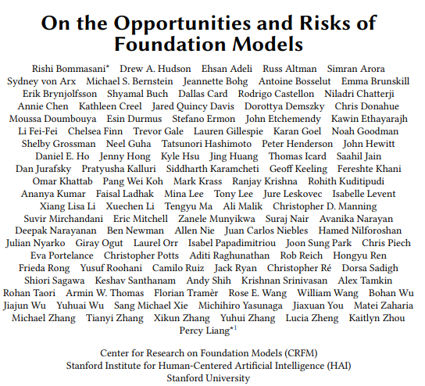
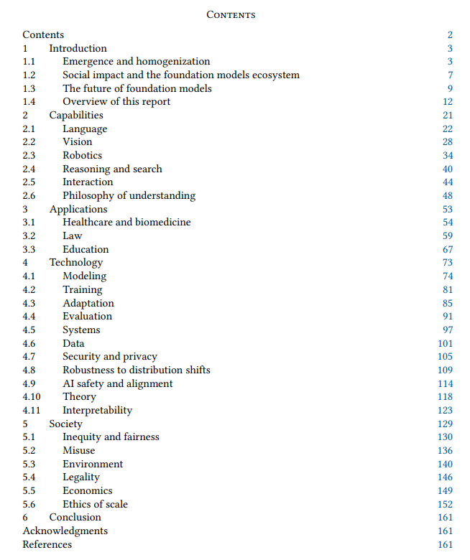
Foundation models : a « paradigm shift » ¹ in AI ?
[1] On the Opportunities and Risks of Foundation Models, Bommasani (Stanford) (2022)

Slide 3
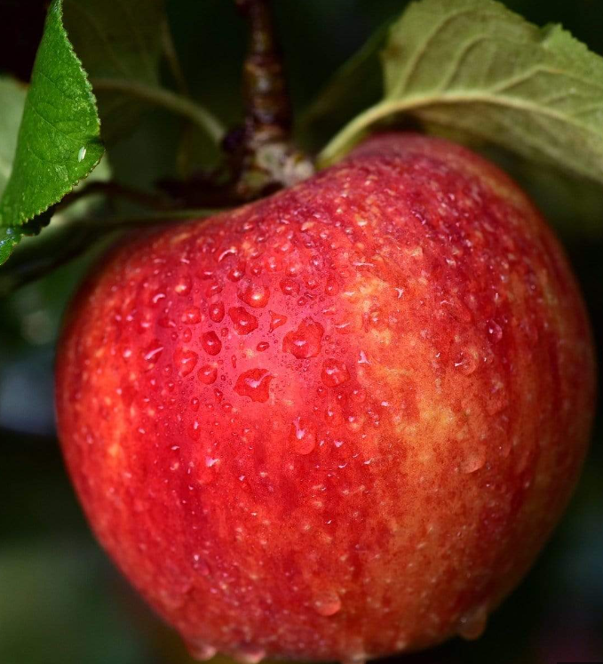
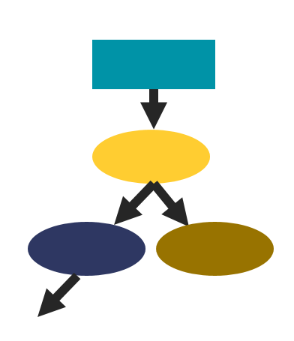
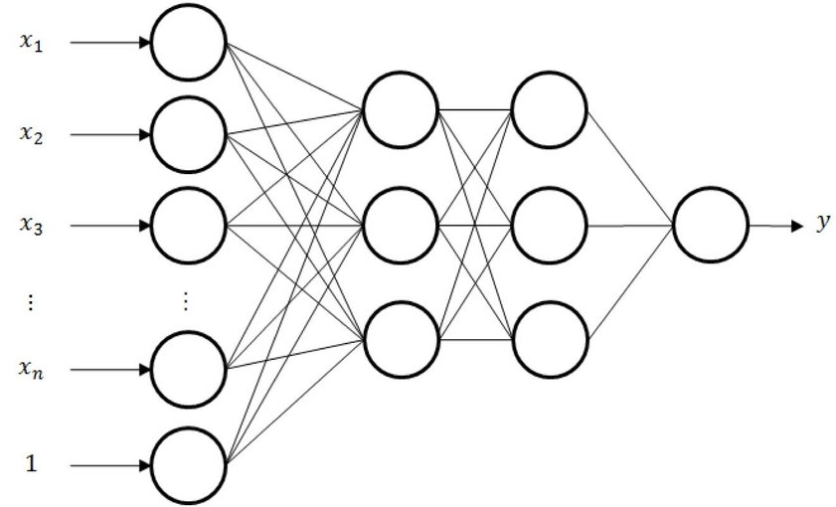
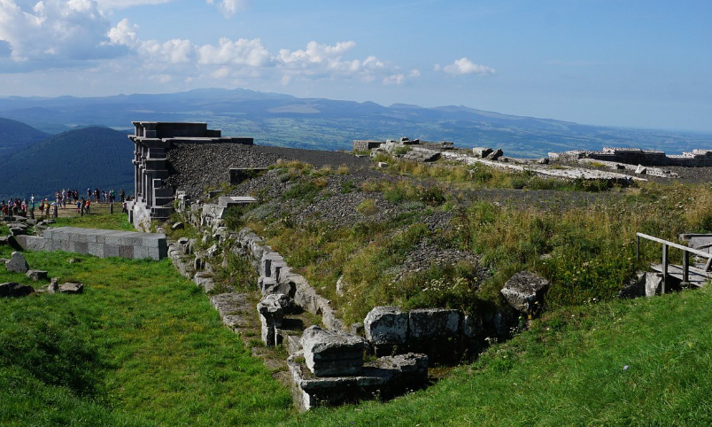
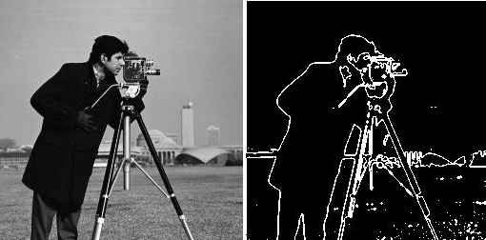
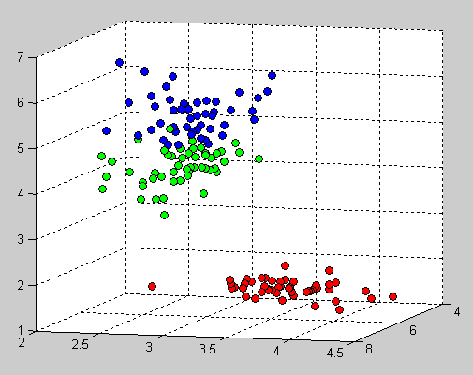
Foundation models : a « paradigm shift » ¹ in AI ?
How do we teach a computer to detect if an image contains an apple ?
1990s
2010s
2020s
Specialized algorithms
«Traditional » (GOF) Machine Learning
Deep Learning
Foundation models
Dataset : ~ 100 images (for human training).
Instruction : « If you find a number of red pixels over this threshold and a shape round enough, image contains an apple. »
Dataset : ~ 1K labeled images with and without apples.
Instruction : « Look for red and circles to figure out if image is apple.»
Homogenization of :
classification algorithms.
Dataset : ~ 1M labeled images with and without apples.
Instruction : « Figure out if this image contains an apple.»
Homogenization of :
feature extraction algorithms.
Dataset : ~ 1B weakly labeled/ unlabeled images not nec. apple related.
Instruction : « Figure out if this image contains an apple.»
Homogenization of :
tasks.
[1] On the Opportunities and Risks of Foundation Models, Bommasani (Stanford) (2022) (figure is also inspired by that paper)

Slide 4


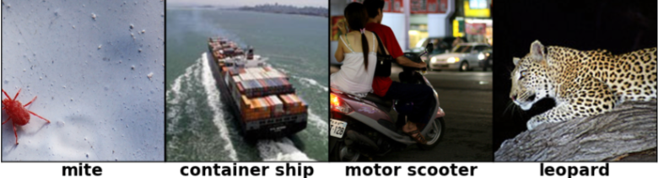
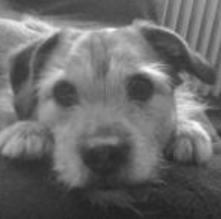
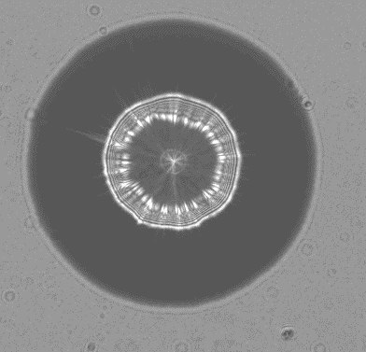
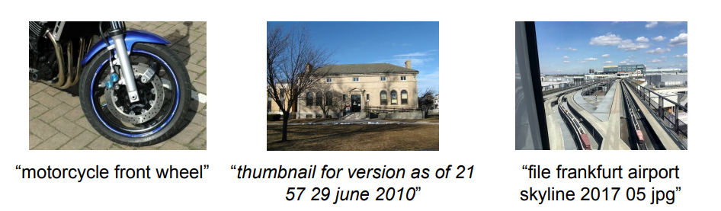
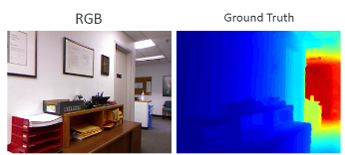
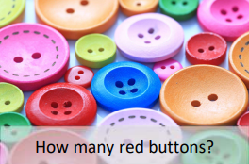
Foundation models scale up pre-training
Traditional Deep Learning
Pre-training (PT) : large dataset, generic task.
PT and downstream (DS) tasks are often « close ».
Fine-tuning on DS task.
Pre-training
Downstream task
weight transfer
ImageNet
classification
/
PT dataset
Feature extraction
Classif
apples
classification
Feature extraction
DS dataset
Classif
animal classification
cell classification
…
Foundation models
PT : very large dataset, very generic task.
PT and DS tasks can be very different.
Light / no fine-tuning on DS task.
Pre-training
Downstream task
Prompting
PT dataset
weight transfer
ALIGN
captioning
Feature extraction
Feature extraction
Classif
apples
classification
DS dataset
Classif
depth prediction
visual QA
…

Slide 5
Foundation models scale up pre-training
Pre-training
Downstream task
Prompting
PT dataset
weight transfer
ALIGN
captioning
Feature extraction
Feature extraction
Classif
apples
classification
DS dataset
Classif
depth prediction
visual QA
…
↘↘ fine-tuning
↗↗ range of DS tasks
1
A foundation model is any model that is trained on broad data (…) that can be adapted (e.g., fine-tuned) to a wide range of downstream tasks. (…)
From a technological point of view, [they] are not new — they are based on deep NNs and [pre-training], which have existed for decades.
However, the sheer scale and scope of foundation models from the last few years have stretched our imagination of what is possible.
1
Transfer learning is what makes foundation models possible, but scale is what makes them powerful. Scale required three ingredients:
(i) improvements in computer hardware, e.g., GPU throughput and memory have increased 10× over the last four years,
(ii) the development of the Transformer (…) that leverages the parallelism of the hardware to train much more expressive models than before,
(iii) the availability of much more training data.
[1] On the Opportunities and Risks of Foundation Models, Bommasani (Stanford) (2022)

Slide 6
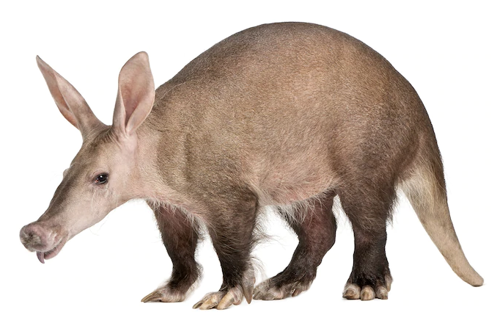
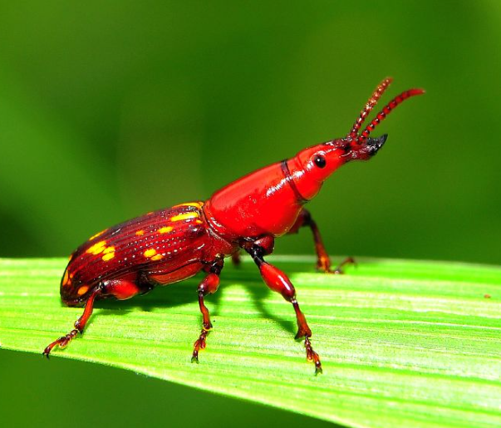

Foundation models started in NLP
→ Straightforward generic PT task :
Language modeling : understand language,
i.e., be able to predict probability distribution of unknown words given a context.
context
relative probability
« Dogs are … »
Network
max
« cool »
aardvark
…
…
abandon
cool
zythum
zyzzyva
aardvark
zyzzyva
words in dictionnary
(oryctérope)
→ Easy to gather very large datasets : self-supervised learning.
training dataset
« Dogs are cool. »
backprop
ground truth
(self-supervised)
« Last week, Emmanuel Macron met Angela Merkel. »
context
«To the red country and part of the gray country of Oklahoma, the last rains came gently, and they did not cut the scarred earth. »
« Dogs are cool »
Network
aardvark
…
…
abandon
cool
zythum
zyzzyva
aardvark
…
…
…
abandon
cool
zythum
zyzzyva
Easy to gather

Slide 7
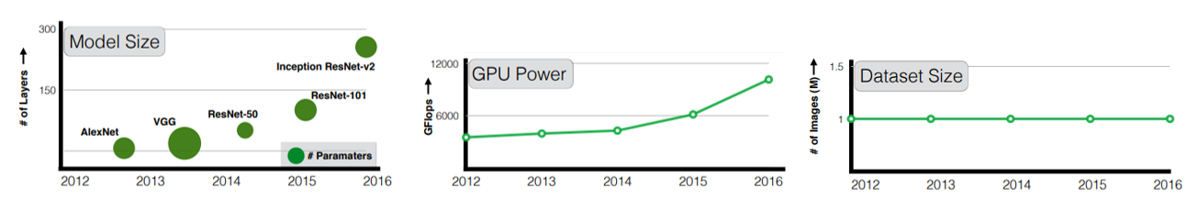
What of vision ?
1
The curious case of vision datasets : while GPU (…) power and model sizes have increase[d] (…), size of the largest training dataset has surprisingly remained constant.
ImageNet²
1
# images : 1M
source : internet
labeling : manual
[1] Revisiting Unreasonable Effectiveness of Data in DL Era, Sun (2017)
[2] ImageNet: A large-scale hierarchical image database, Deng (2009)

Slide 8
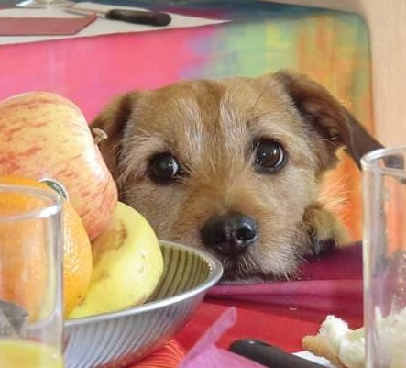


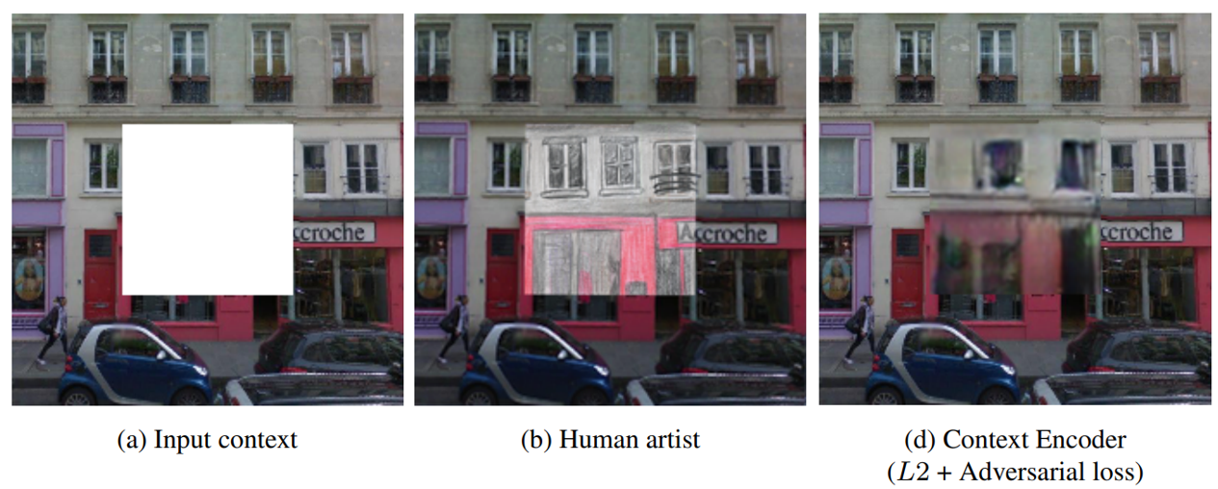
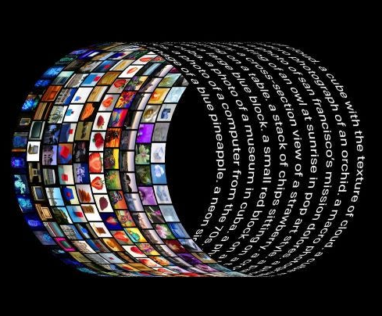


How to scale CV datasets ?
Self-supervise in image space
Automatic labeling in « ML format »
Automatic labeling
with natural language supervision
This is my dog Vodka, he is very cute !
dog
e.g. in-painting²
e.g. Instagram-3,5B³
e.g. CLIP⁴
Chilling !
#beach
beach
[1] On the Opportunities and Risks of Foundation Models, Bommasani (Stanford) (2022)
[3] Exploring the Limits of Weakly Supervised Pretraining, Mahajan (2018)
[2] Context encoders : feature learning by inpainting, Pathak (2016)
[4] Learning Transferable Visual Models From Natural Language Supervision, Radford (OpenAI) (2021)
Notes:
1 : citer aussi Masked auto-encoder (SAM)
2 : citer aussi

Slide 9
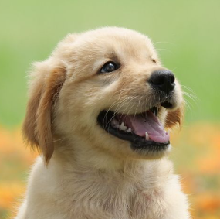
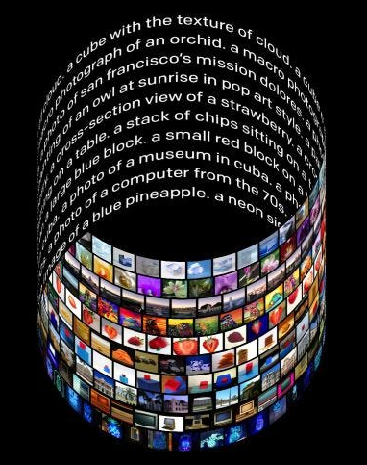
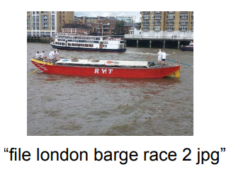

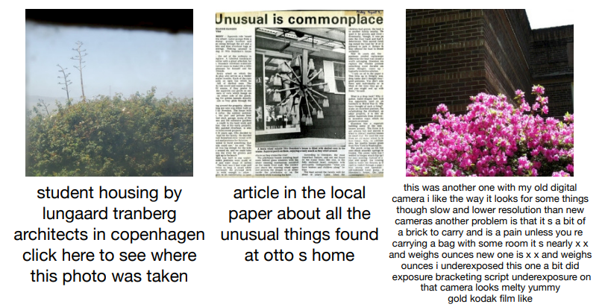
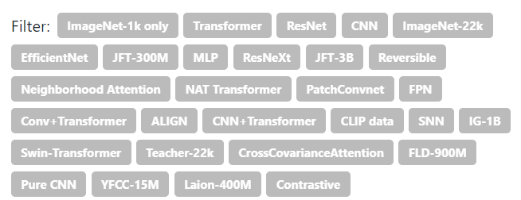
NLS is easily scalable
Most images on the web are associated with a natural language text rather than a « ML-format » label.
→ Easy to scale NLS datasets by simple web crawl.
dog
my dog Rex : he’s so cute !
Yahoo Flickr dataset¹
WebImageText²
ALIGN dataset³
# images : 90M
source : Flickr
labeling : uploader captions
# images : 400M (~ GPT-2)
source : internet
labeling : « associated » text
# images : 1.8B
source : internet
labeling : alt-text
Noisy…
but big is better than clean.
SotA : weight shift from architecture to dataset
1
filters on IN classification leaderboard (paperswithcode)
3
The scale of our corpus can make up for its noise and leads to SotA representations.
[1] YFCC100M: The New Data in Multimedia Research, Thomee (2016)
[3] Scaling Up Visual and Vision-Language Representation Learning (…), Jia (Google) (2021)
[2] Learning Transferable Visual Models From Natural Language Supervision, Radford (OpenAI) (2021)
FLAVA: A Foundational Language And Vision Alignment Model
[5] Learning (…) Visual Models From Language (…), Radford (2021)
[6] Scaling Up (…) with Noisy Text Supervision, Jia (2021)
Notes:
SNN : spiking neural network
FPN : Feature Pyramid network
So big that we can change paradigm : no fine-tuning
Scrap internet for images associated with the 500k words most common in Wikipedia

Slide 10
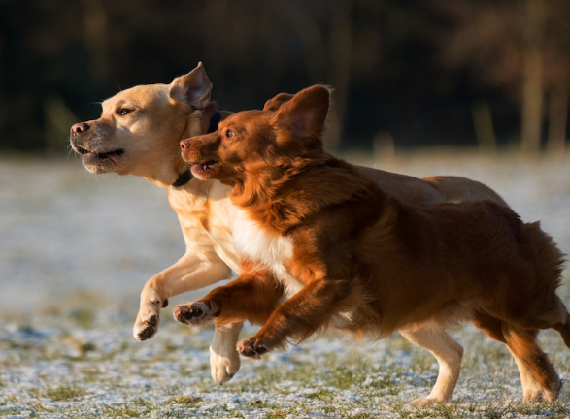
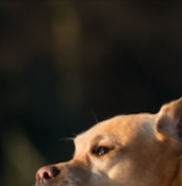
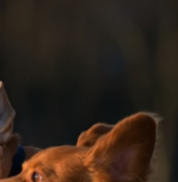
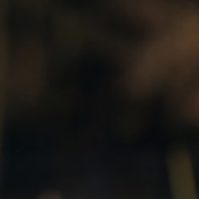
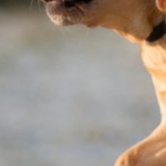
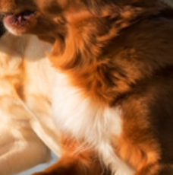
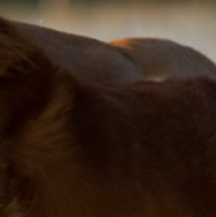
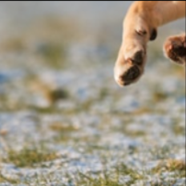
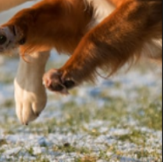
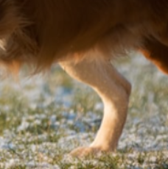
Self-supervision with NLS : generative methods
Learn a joint visual and text representation through masking.
Simple Vision-Language Model (SimVLM)¹
dog are running on the beach.
Decoder (Transformer)
Encoder (Transformer)
Embedding
Embedding
A brown dog and a white dog are running on the beach
A brown dog and a white
« Prefix LM » : add image as prefix to LM task → many other fusion implementations are possible²
[1] SimVLM : Simple visual language model pretraining with weak supervision, Wang (Google) (2022)
[2] FLAVA: A Foundational Language And Vision Alignment Model, Singh (Meta) (2022)
[3] Learning Transferable Visual Models From Natural Language Supervision, Radford (OpenAI) (2021)

Slide 11
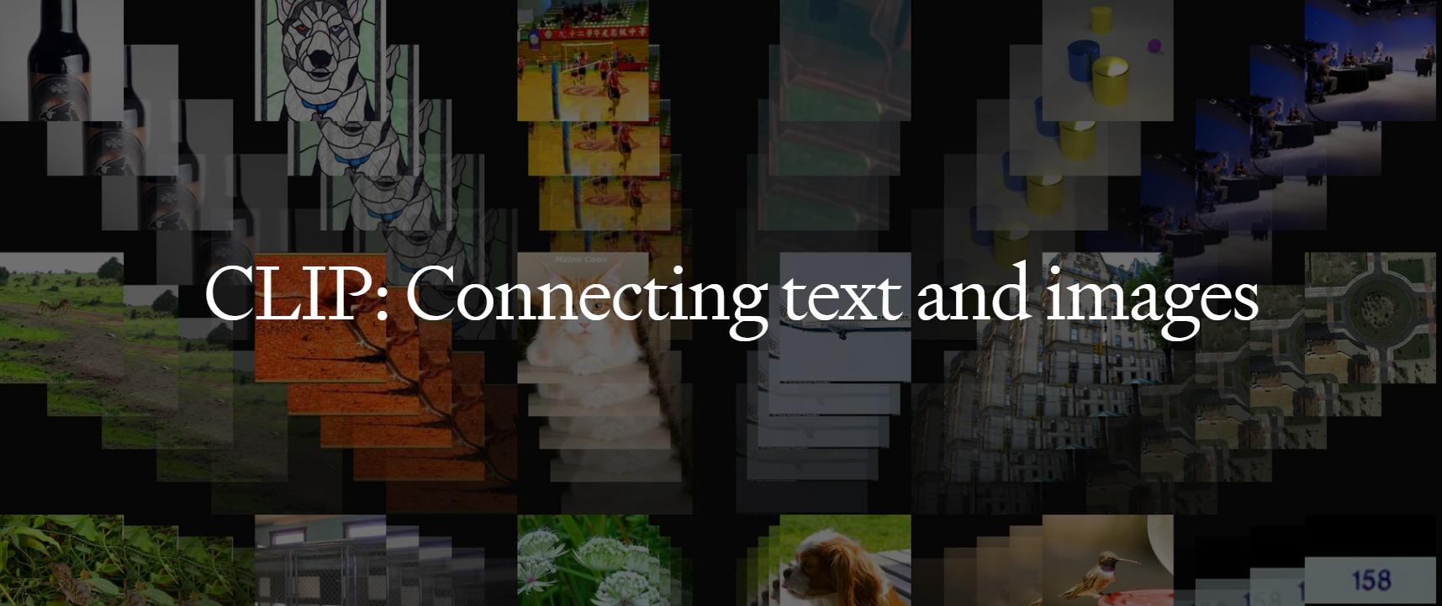
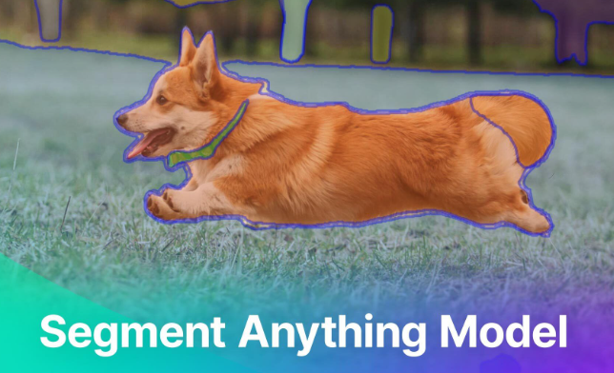
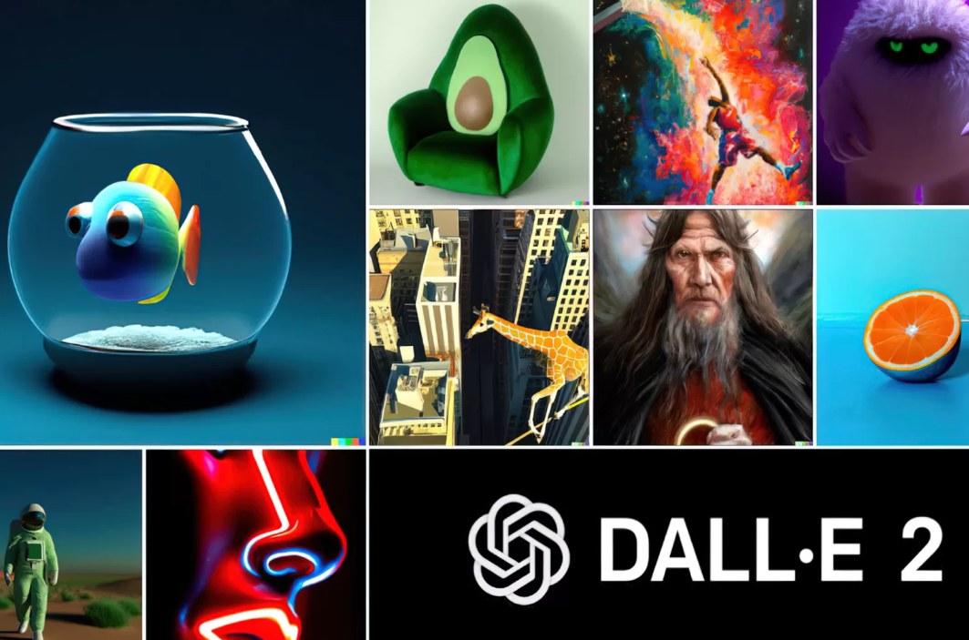
Self-supervision with NLS : contrastive methods
Contrastive Language-Image Pre-training (CLIP)¹
FM using NLS and contrastive learning
3rd most cited AI paper in 2021 (after AlphaFold² and Swin³).
Building block of further widely-used FMs.
4
5
[1] Learning Transferable Visual Models From Natural Language Supervision, Radford (OpenAI) (2021)
[2] Highly accurate protein structure prediction with AlphaFold, Jumper (DeepMind) (2021)
[4] Segment Anything, Kirillov (Meta) (2023)
[3] Swin Transformer: Hierarchical Vision Transformer using Shifted Windows, Liu (Microsoft) (2021)
[5] Hierarchical Text-Conditional Image Generation with CLIP latents, Ramesh (OpenAI) (2021)

Slide 12
Contrastive loss
Born in the field of metric learning.
Metric Learning : compute feature space where distance is correlated to some semantic distance in input space.
Training
Inference
feature space
In which section of the feature space does this point lie ?
→ class
input space
classification
?
Which cluster is this point closest to, and what is its distance to it ?
class
distance to class
in or out-of-distribution¹
metric learning
?
metric space
Applications : many classes, few points per class, important to know if in/out distribution, e.g. face recognition².
[1] Out-of-distribution detection based on distance metric learning, Yang (2020)
[2] FaceNet: A Unified Embedding for Face Recognition and Clustering, Schroff (2015)

Slide 13

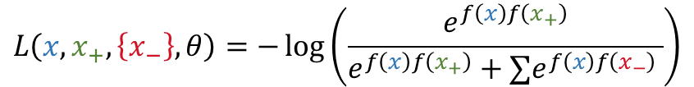


Contrastive loss
Classification loss has no incentive to create « metric space » (« only » focused on class partionning)
→ need new « contrastive » loss¹.
two points in input space
$$L\left(x_{i}, x_{j}, θ\right)=\text{𝟙}\left[y_{i}=y_{j}\right]\left(f_{θ}\left(x_{i}\right)−f_{θ}\left(x_{j}\right)\right)−\text{𝟙}\left[y_{i}≠y_{j}\right]\left(f_{θ}\left(x_{i}\right)−f_{θ}\left(x_{j}\right)\right)$$
parameters of network $f$
case where $x_{i}$ and $x_{j}$ are same “class”
case where $x_{i}$ and $x_{j}$ are different “class”
→ minimal when « same » points are projected close and « different » ones far away
metric space
Efficient implementation : multi-class N-pair loss^{2,3} (a.k.a. InfoNCE loss, NT-Xent…)
$$L\left(x, x_{+}, \left\{x_{−}\right\},θ\right)=−\log\left(\frac{e^{f\left(x\right)f\left(x_{+}\right)}}{e^{f\left(x\right)f\left(x_{+}\right)}+∑e^{f\left(x\right)f\left(x_{−}\right)} }\right)$$
→ minimal when paired points have similar projection ($f\left(x\right)f\left(x_{+}\right)$ high)
and unpaired points have different projection ($f\left(x\right)f\left(x_{−}\right)$ low)
batch
[1] Learning a similarity metric discriminatively, with application to face verification, Shopra, LeCun (2005)
[2] Improved Deep Metric Learning with Multi-class N-pair Loss Objective, Sohn (2016)
[3] Representation Learning with Contrastive Predictive Coding, van dan Oord (Google) (2019)

Slide 14
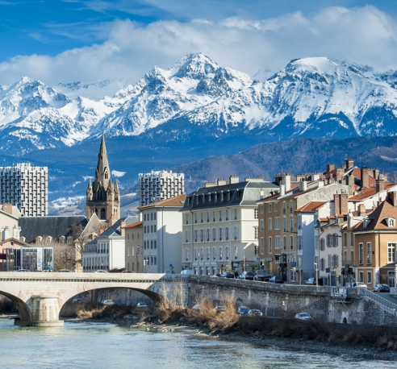


























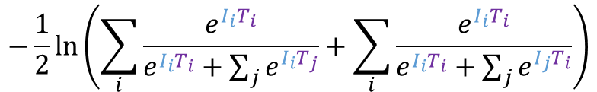
CLIP : training
Pikachu is an electric type Pokemon.
My dog Rex : he’s so cute !
love living here.
WebImageText
Text encoder (Transformer)
Dataset :
# images : 400M (~ GPT-2)
source : internet
labeling : « associated » text
$$T_{0}$$
$$T_{1}$$
$$T_{2}$$
.
.
.
$$I_{0}$$
$$I_{0}$$
$$T_{0}$$
$$I_{0}$$
$$T_{1}$$
$$I_{0}$$
$$T_{2}$$
Training batch :
.
.
.
My dog Rex : he’s so cute !
Pikachu is an electric type Pokemon.
$$I_{1}$$
$$I_{1}$$
$$T_{0}$$
$$I_{1}$$
$$T_{1}$$
$$I_{1}$$
$$T_{2}$$
love living here.
Image encoder (ViT)
correct image-text pair for image $i$
.
.
.
$$I_{2}$$
$$I_{2}$$
$$T_{0}$$
$$I_{2}$$
$$T_{1}$$
$$I_{2}$$
$$T_{2}$$
$$−\frac{1}{2}ln\left(\sum_{i}{\frac{e^{I_{i}T_{i}}}{e^{I_{i}T_{i}}+\sum_{j}{e^{I_{i}T_{j}}}}}+\sum_{i}{\frac{e^{I_{i}T_{i}}}{e^{I_{i}T_{i}}+\sum_{j}{e^{I_{j}T_{i}}}}}\right)$$
Loss :
all other incorrect image-text pairs for image $i$
Our initial approach (…) jointly trained an image CNN and text transformer (…) to predict the caption of an image. However, we encountered difficulties (…) : Try[ing] to predict the exact words of the text accompanying each image [is] a difficult task due to the wide variety of descriptions (…) that co-occur with images.
Recent work (…) has found that contrastive objectives can learn better representations than their equivalent [generative] objective.
Notes:
Ordre d’idée d’entrainement : un mois sur 500 GPUs
Nb de params : de l’ordre de ViT (600M) + Transformer (60M)

Slide 15
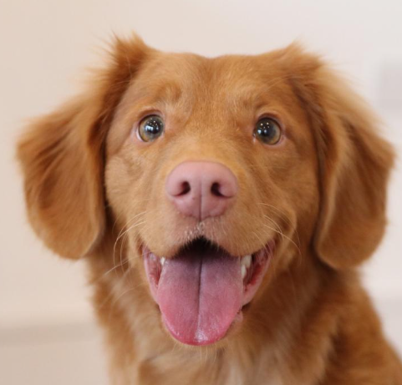


















CLIP : inference
Dataset size big enough to enable zero-shot (i.e. no fine-tuning) inference ( → LLMs)
downstream task
(e.g. ImageNet)
apple
bag
…
dog
…
zoo
When interpreted this way, the image encoder is the computer vision backbone which computes a feature representation for the image and the text encoder (…) generates the weights of a linear classifier.
Text encoder
$$T_{0}$$
$$T_{1}$$
…
$$T_{i}$$
…
$$T_{n}$$
.
.
.
.
$$T_{0}$$
…
…
$$I$$
$$I$$
$$T_{0}$$
$$I$$
$$T_{1}$$
$$I$$
$$T_{i}$$
$$I$$
$$T_{n}$$
Image encoder
$$I$$
$$z_{apple}$$
softmax
Image encoder
$$z_{bag}$$
softmax
$$z_{cat}$$
apple
bag
…
dog
…
zoo
…
argmax
dog
Performance on IN top-1 : 76%, ~ supervised ResNet-50
CLIP can be applied to any visual classification benchmark by simply providing the names of the visual categories to be recognized, similar to the “zero-shot” capabilities of GPT-2 and GPT-3.
Prompt engineering¹ : ~ +5 points.
« apple » → « a picture of an apple »
[1] Making pre-trained language models better few-shot learners, Gao (2020)

Slide 16
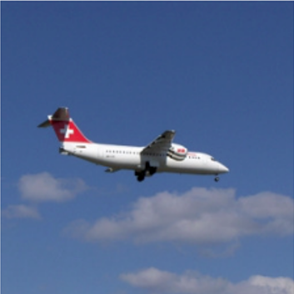
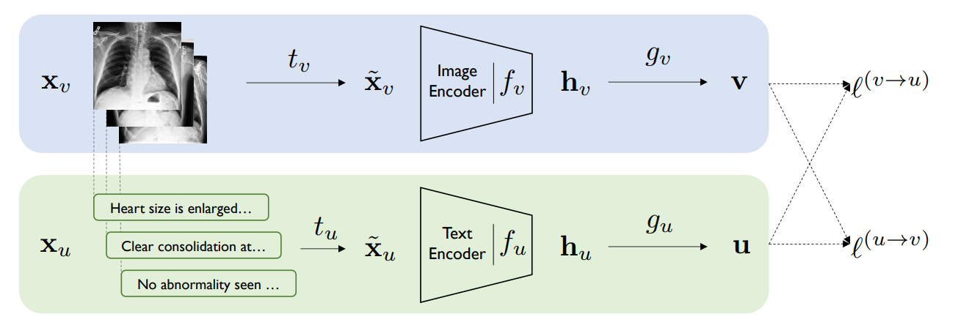

CLIP : Inspirations
Visual $n$-grams¹ : large pre-training with NLS + ZS on downstream tasks.
Training
Inference
apple
apple
an apple
bag
plane approaching zrh avro regional jet rj
CNN
…
…
Dataset : YFCC
Zero-shot to IN : 11% accuracy
plane
CNN
leopard
plane approaching
filtering most common
…
…
plane
who was
zoo
plane approaching
jet
most common $n$-grams
in a corpus, $n∈\left[1,5\right]$
classes of ImageNet also appearing in the pre-training task
regional jet
Contrastive VIsual Representation learning from Text (ConVIRT)² : contrastive alignment of images and text.
Dataset : 200k image-text pairs
Main difference in CLIP : scale and scope
CLIP training is simplified
[1] Learning Visual N-Grams from Web Data, Li (2016)
[2] Contrastive Learning of Medical Visual Representations from Paired Images and Text, Zhang (2020)

Slide 17
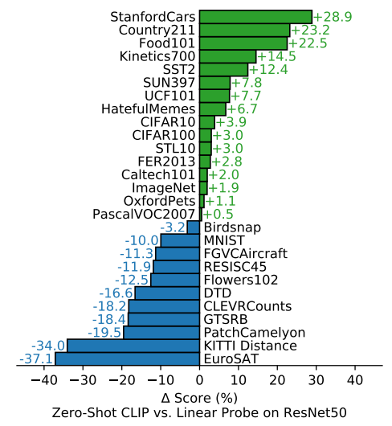
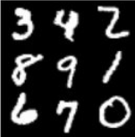

CLIP : Performance (zero-shot)
Comparison on several downstream tasks
ResNet + LP is better
CLIP ZS is better
CNN features + linear probing
Zero-shot CLIP
Downstream task
(e.g. MNIST)
WebImageText
ImageNet
ResNet-50¹
Linear classifier
CLIP
We find that CLIP, similar to the GPT family, learns to perform a wide set of tasks during pre-training.
General classification : similar performance.
Fine-grained classification : depends on relative amount of labels in training set.
Action recognition in videos : CLIP better thanks to natural language supervision.
Specialized / Complex / Abstract : requires some examples.
[1] Deep Residual Learning for Image Recognition, He (Microsoft) (2015)

Slide 18
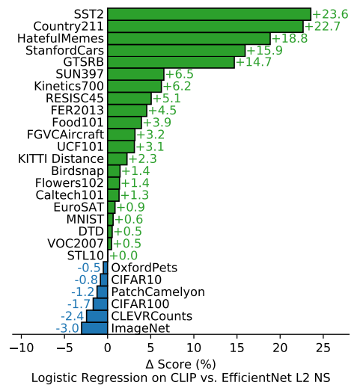
CLIP : Performance (linear probing)
EfficientNet + LP is better
CLIP + LP is better
CNN features + linear probing
CLIP features + linear probing
WebImageText
ImageNet
downstream task
downstream task
EfficientNet¹
Linear classifier
CLIP
Linear classifier
dataset on which EfficientNet features were trained
[1] EfficientNet: Rethinking Model Scaling for Convolutional Neural Networks, Tan (Google) (2019)

Slide 19
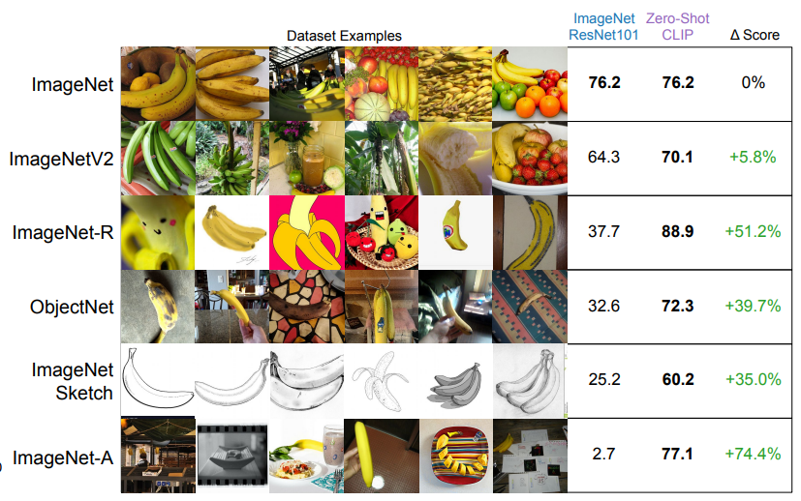
CLIP : Generalization
[1] Do Better ImageNet Models Transfer Better?, Kornblith (Google) (2018)
[2] Do ImageNet Classifiers Generalize to ImageNet? (2019)
Good performance on benchmark (e.g. IN) does not guarantee good performance on other distributions.^{1,2}
Distribution shift
Out-of-distribution generalization
Intuitively, a zero-shot model should not be able to exploit spurious correlations (…) that hold only on a specific distribution, since it is not trained on that distribution.
(zero-shot)
“embarrassing”
CLIP does little to address the underlying problem of brittle generalization of DL models. Instead CLIP (…) hopes that by training on such a large and varied dataset that all data will be effectively in-distribution. This is a naive assumption that, as MNIST demonstrates, is easy to violate.
The recent shift towards large-scale task and dataset agnostic pre-training combined with (…) benchmarking on broad evaluation suites (…) promotes the development of more robust systems and provides a more accurate assessment of performance.
Notes:
V2 : repro du meme jeu
R : cartoon, dessins, etc
A : mis-classified by ResNet models
ObjectNet : moins centré, plus d’angles, de background foireux
Robustness comes from :
CLIP architecture ?
Natural Language supervision ?
Large dataset ?
Not training on ImageNet ?

